Slide 1

Advertisement Board using LED-Dot Matrix
Prepared by:
1.Belayneh Mathewos ATR/3742/07
2.Selamu Abo ATR/7293/07
3.Derartu Mengesha ATR/1812/07
4.Terbinos Getachew ATR/9045/07
5.Abel Tefera ATR/4360/07
6.Nahom Girmay ATR/5368/07
04/02/2018

Slide 2
Outline
Introduction
Objective
Design Detail
Project Demonstration
Conclusion
The End
04/02/2018

Slide 3
Introduction
Advertisement board by using Dot Matrix is a message display board. In this presentation the Design Detail elaborate the approach of design, the component used, the software that we used to simulate the design and finally the Demonstration part shows some part of design simulation
04/02/2018

Slide 4
Objectives
The main objectives of this project is to design advertisement board to display any messages in Amharic for different organizations like business companies, hospitals, colleges, etc.
04/02/2018

Slide 5
Design Detail
To Design the Project we used the Arm Architecture. We designed the pattern for all for all Amharic letters and the mapping between them. The design contains the following:-
The Pattern Design:- To optimize our pattern, we group
the same patterns those can be displayed at a time and we put the patterns in the array.
A character can be displayed simply by accessing the patterns in the
array. We try to design the pattern almost for 231 Amharic letters
04/02/2018

Slide 6
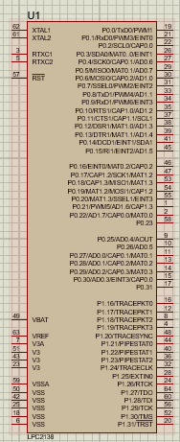
Continued….
The Components Used:- The components used are the followings
1. LPC 2148 – is a microcontroller
and it has 47 active ports.
- Used to control the output displayer.
04/02/2018

Slide 7
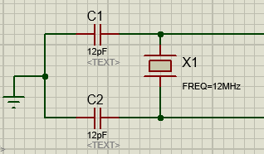
Continued….
2. External oscillator Circuit –To generate the needed frequency because the microcontroller frequency is very high and inconsistent with our design.
04/02/2018

Slide 8
Continued….
3. Timer – To generate the necessary delay to display a the message on the board
- To get the desired peripheral frequency we used 12MHz frequency from external oscillator.
1msec delay to display the different patterns in the single character.
0.5msec delay to display the character on different display board
04/02/2018

Slide 9
Continued….
2. Timer –Delay calculation
Fosc=12MHz
->CCLK=60MHz=M*Fosc ->M=5,but (M=5-1=4) since
->Fcco=CCLK*2*P=240,P = 2 it satisfies the valid range for Fcco
->the multiplier and divider setup values are the values which are loaded into
PLLCFG register->PLLCFG=0x24.
->Since in LPC->VPBDIV=0x00
PCLK= CCLK/4=15MHz
->The prescalar value(let's=3750) the value that loaded into the register PR(for us 0PR=3750)
// No. of prescalar value(count)=(peripheral frequency(15MHz) x time delay in sec)-1.
//here we are using 0.25msec delay, and for us PCLK= CCLK/4
To delay 1msec, use TIMER COUNTER register, TC (for usT0TC) = 4,
WHICH is to count up to 4(T0TC < 4) as a loop up to 4.
->which is used to delay 1msec
04/02/2018

Slide 10
Continued….
2. Matrix 8-8 display board – It is 8 by 8 matrix display board
Proteus software:- To simulate the design we used proteus version 8.5.
04/02/2018

Slide 11
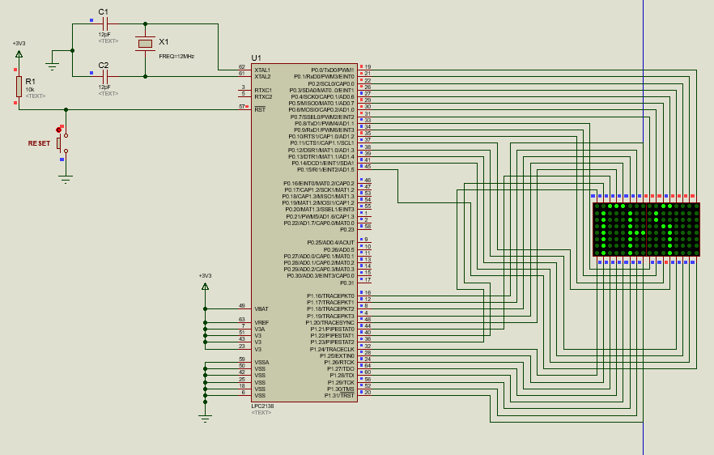
Project Demonstration
The following pictures show Shows the schematic view of the design in proteus
04/02/2018

Slide 12
Conclusion
The Design is only to display Amharic messages on the board so, this project is specifically designed for domestic uses only. As we know Amharic is official language in Ethiopia so advertisements in Amharic helps many people to understand the message easily and avoid misunderstanding.
04/02/2018

Slide 13

The End
04/02/2018

